Slide 1
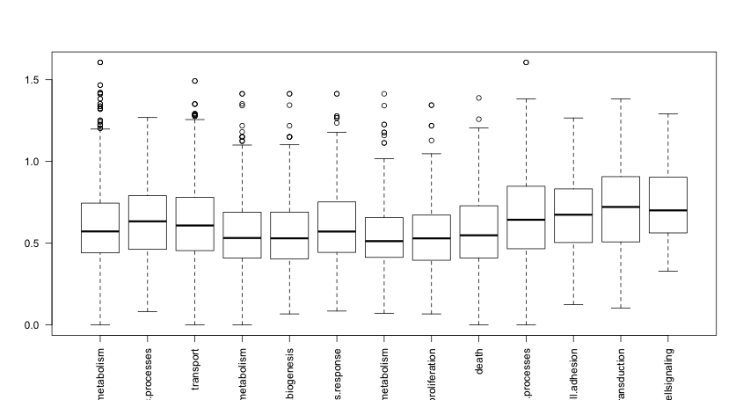
CpG Ratio
Death
Transport
Cell Cycle and Proliferation
Developmental Processes
Other Metabolic Processes
Cell Organization and Biogenesis
Cell Adhesion
RNA Metabolism
DNA Metabolism
Protein Metabolism
Stress Response
Cell-Cell Signaling
Signal Transduction

